Slide 1
Decentralized Identity Verification System By Blockchain And Etherium ,metamask And W3C DID
SlideMake.com

Slide 2
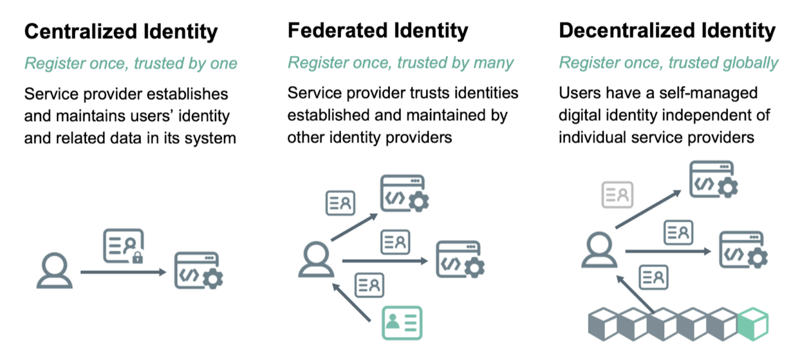
Introduction to Decentralized Identity Verification
Decentralized identity verification leverages blockchain technology to enhance security and privacy.
This system eliminates the need for centralized authorities to manage identity data.
By utilizing decentralized methods, users gain greater control over their personal information.
Notes:
Image source: https://d112y698adiu2z.cloudfront.net

Slide 3
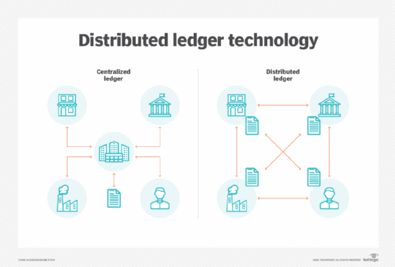
What is Blockchain Technology?
Blockchain is a distributed ledger technology that ensures transparency and immutability.
Each transaction is recorded in a block and linked to previous blocks, creating a secure chain.
This technology eliminates single points of failure, making data tampering nearly impossible.
Notes:
Image source: https://cdn.ttgtmedia.com

Slide 4
Overview of Ethereum
Ethereum is a leading blockchain platform that enables smart contracts and decentralized applications (dApps).
Smart contracts automatically execute actions based on predefined conditions, enhancing trust.
The Ethereum ecosystem supports various decentralized identity solutions through its programmable features.
Notes:
Image source: https://www.researchgate.net

Slide 5
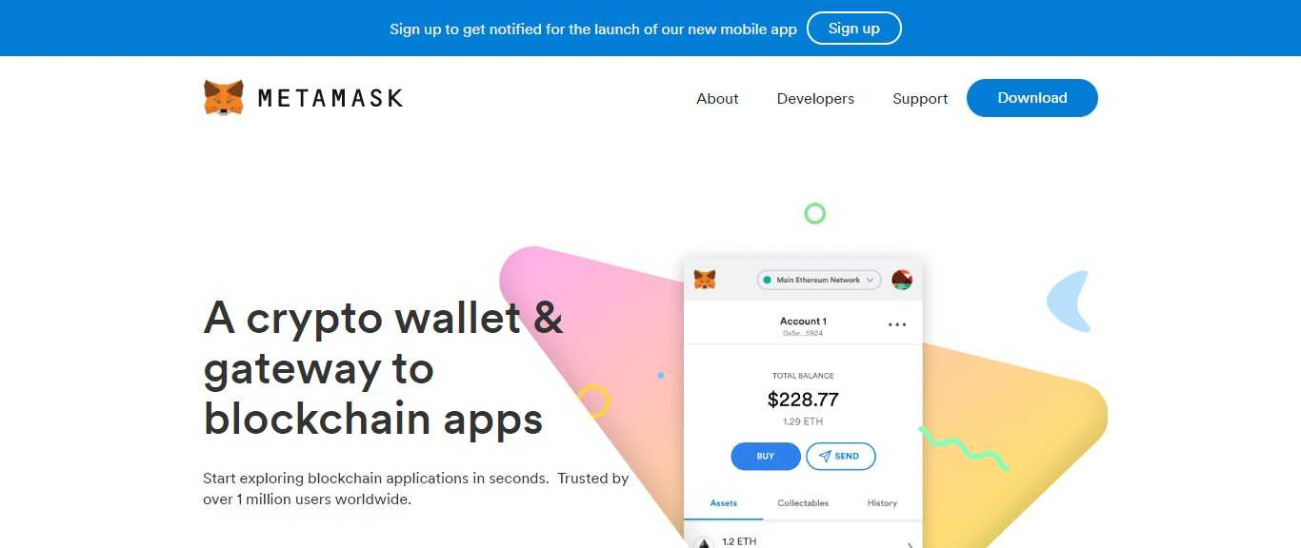
Role of MetaMask
MetaMask is a cryptocurrency wallet and gateway to blockchain applications, facilitating easy access to Ethereum.
It allows users to manage their digital identities and interact with dApps securely.
With MetaMask, users can store their private keys safely, ensuring the security of their digital identities.
Notes:
Image source: https://coinworldstory.com

Slide 6
Understanding W3C DID
The World Wide Web Consortium (W3C) Decentralized Identifier (DID) specification provides a framework for creating and managing decentralized identities.
DIDs are unique identifiers that enable individuals to own and control their identity data.
This standard promotes interoperability across various platforms and services.
Notes:
Image source: https://www.researchgate.net

Slide 7

Benefits of Decentralized Identity Verification
Users maintain full ownership of their identity data, reducing the risk of identity theft.
Decentralized systems offer greater privacy, as personal information is not stored on central servers.
Enhanced security and trust are achieved through cryptographic methods inherent in blockchain technology.
Notes:
Image source: https://spyverificationservices.com

Slide 8
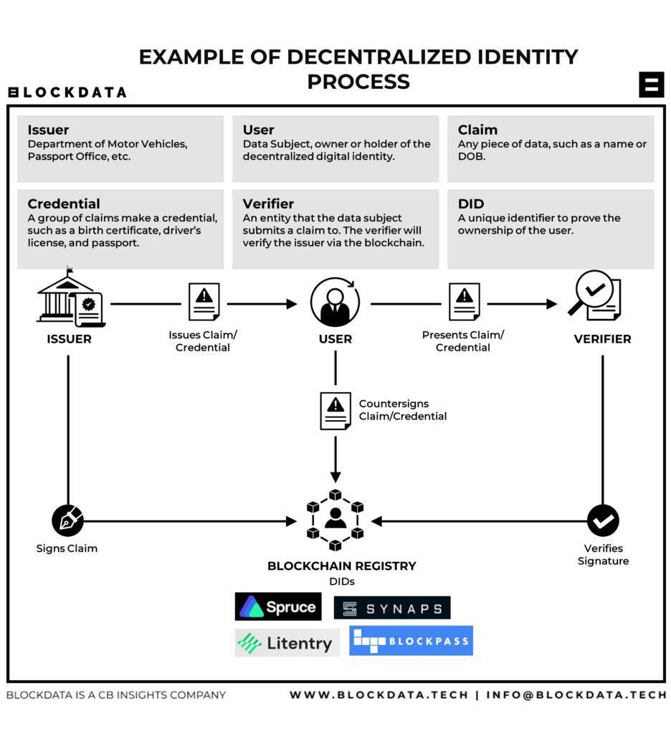
Use Cases of Decentralized Identity
Decentralized identity can be applied in various sectors, including finance, healthcare, and education.
For instance, it allows for secure and verifiable credentials for educational qualifications.
In finance, it streamlines KYC processes, reducing fraud and improving customer experience.
Notes:
Image source: https://research-assets.cbinsights.com

Slide 9
Challenges and Considerations
Despite its advantages, decentralized identity verification faces challenges like user adoption and regulatory compliance.
The technology requires significant changes in existing systems and processes, which can be a barrier.
Ensuring usability and accessibility for all users is crucial for widespread adoption.
Notes:
Image source: https://spyverificationservices.com

Slide 10
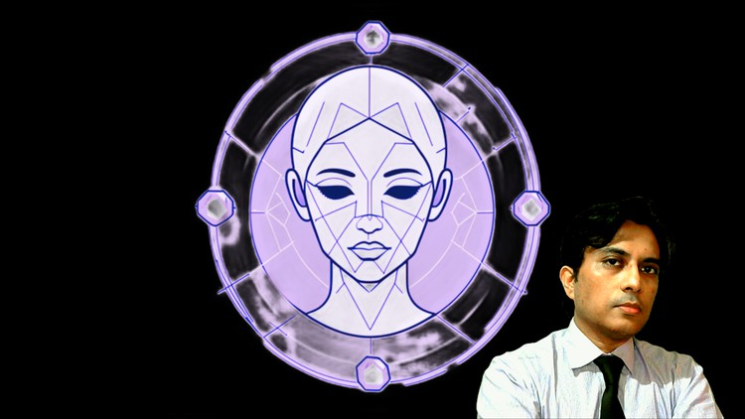
Future of Decentralized Identity Systems
The future of decentralized identity systems is promising with advancements in blockchain technology.
Increasing demand for privacy and security will drive innovation in this space.
Collaborations between governments, organizations, and developers will further enhance the ecosystem.
Notes:
Image source: https://thumbs.comidoc.net

Slide 11
Conclusion
Decentralized identity verification presents a revolutionary approach to managing personal data.
By harnessing blockchain, Ethereum, MetaMask, and W3C DIDs, users can achieve secure and private identity management.
The ongoing evolution of this technology will shape the future of digital identity.
Notes:
Image source: https://d112y698adiu2z.cloudfront.net

Slide 12
References
W3C. (2023). Decentralized Identifiers (DIDs) v1.0. Retrieved from https://www.w3.org/TR/did-core/
Ethereum Foundation. (2023). Ethereum White Paper. Retrieved from https://ethereum.org/en/whitepaper/
MetaMask. (2023). About MetaMask. Retrieved from https://metamask.io/

